Slide 1

Interviewing
Ashley Clack
‪www.collegegrad.com

Slide 2

What is an Interview?
Definition- the way in which information is collected via direct communication comprised of reciprocal exchange (Cohen, Swerdlik, & Sturman, 2013).
Commonly utilized by
psychologists to
collect information
‪www.123rf.com

Slide 3
What is an interview?
Utilized by psychologists to:
Diagnose
Identify matters to be addressed in therapy
Evaluate clients’ likelihood of hurting themselves or others
Make diagnostic decisions
Make treatment decisions
Make selection decisions
Make other decisions (Cohen, Swerdlik, & Sturman, 2013).

Slide 4

Appearance and Professionalism
Important in the interviewee’s perception of the interviewer
Appearance should be professional; interviewer should look well-groomed
Interviewer should appear friendly and non-threatening (Florida International University, 2012).
‪www.w-z.com

Slide 5

Nonverbal Communication Elements
Body language
Movements
Facial expressions in response to the interviewer
Extent of eye contact
Apparent willingness to cooperate (Cohen, Swerdlik, & Sturman, 2013).
‪blog.readytomanage.com

Slide 6
Nonverbal Communication Elements
General reaction to the demands of the interview
How interviewee is dressed
Sloppy versus neat
Inappropriate versus appropriate (Cohen, Swerdlik, & Sturman, 2013).
Phone
Voice pitch
Extent to which particular questions precipitate long pauses or signs of emotion in response (Cohen, Swerdlik, & Sturman, 2013).

Slide 7

Verbal Communication Elements
Respect, empathy, and genuineness should be communicated
Acceptance should be demonstrated (Florida International University, 2012).
Begin with open-ended questions (Cohen, Swerdlik, & Sturman, 2013).
‪www.rightattitudes.com

Slide 8
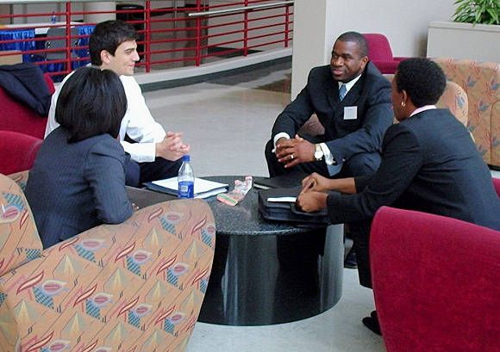
Verbal Communication Elements
Follow with closed-ended questions (Cohen, Swerdlik, & Sturman, 2013).
Include
Statements of understanding
Frequent statements of summarization (Cohen, Swerdlik, & Sturman, 2013).
‪blog.bizeso.com

Slide 9
How to Begin an Interview
Build rapport
Provide the interviewee with information regarding the role of the interviewer and a description of the agency
Show respect for the cultural beliefs of the interviewee
Provide an environment to allow for expression of feelings
Acknowledge and address the feelings of interviewees (Florida International University, 2012).

Slide 10

How to Begin an Interview
Engage
Begin with light conversation
Discuss the interview process (Florida International University, 2012).
‪www.navigaservices.com

Slide 11

How to End an Interview
Summarize accomplishments of the session
Summarize what is to be accomplished in future sessions
Show appreciation for their time
Set the date and time for the following interview, if applicable (Florida International University, 2012).
‪www.careersolutionsco.com

Slide 12

How to Ask Questions
Cater questions to the final goal of the interview (Florida International University, 2012).
Ask follow-up questions in response to interesting or relevant responses (Driscoll & Brizee, 2010)
‪www.123rf.com

Slide 13

How Not to Ask Questions
Do not rigidly stick to interview questions
Do not press an issue about which the interviewee does not wish to speak (Driscoll & Brizee, 2010)
‪www.mpiweb.org

Slide 14

Follow-Up Questions
Allows for recovery of deficiencies in the preceding interview
Is said to be the most important part of interviews (Ross & Nilsen, 2000).
‪careercenterpeers.typepad.com

Slide 15
References
Cohen, R. J., Sturman, E. D., & Swerdlik, M. E. (2013). Psychological testing and assessment: An introduction to tests and measurement (8th ed.). Boston, MA: McGraw-Hill.
Driscoll, D. L. & Brizee, A. (2010). Interviewing. Retrieved from https://owl.english.purdue.edu/owl/resource/559/04/
Florida International University. (2012). Introduction to Interviewing: Participant Guide. Retrieved from http://centerforchildwelfare.fmhi.usf.edu/preservice/participantguides/Intro%20to%20Interviewing%20Participant%20Guide.pdf
Ross, C. S., & Nilsen, K. (2000). Has the internet changed anything in reference? Reference & User Services Quarterly, 40(2), 147-154. Retrieved from http://web.ebscohost.com/ehost/pdfviewer/pdfviewer?sid=9ace9ce9-db40-4c15-ac78-0c3624651163%40sessionmgr4003&vid=2&hid=4204

